Slide 1
Operating System Structures

Slide 2
Operating System Structures
Operating System Services
Common System Components
System Calls and APIs
System Programs
System Design and Implementation
System Pragmatics

Slide 3
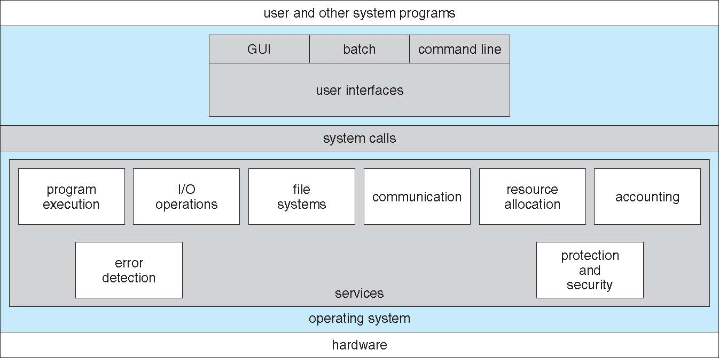

Slide 4
OS Services (user-oriented)
Program execution – OS capability to load a program into memory, run it, end execution, either normally or abnormally (indicating error).
I/O operations – since user programs cannot execute I/O operations directly, the OS must provide some means to perform I/O, which may involve a file or I/O device.

Slide 5
File systems – program capability to read, write, create, and delete files and directories.
Communication – Processes may exchange information, on the same computer or between computers over a network – Implemented via shared memory or message passing.
Error detection – ensure correct computing by detecting errors in the CPU and memory hardware, in I/O devices, or in user programs.

Slide 6
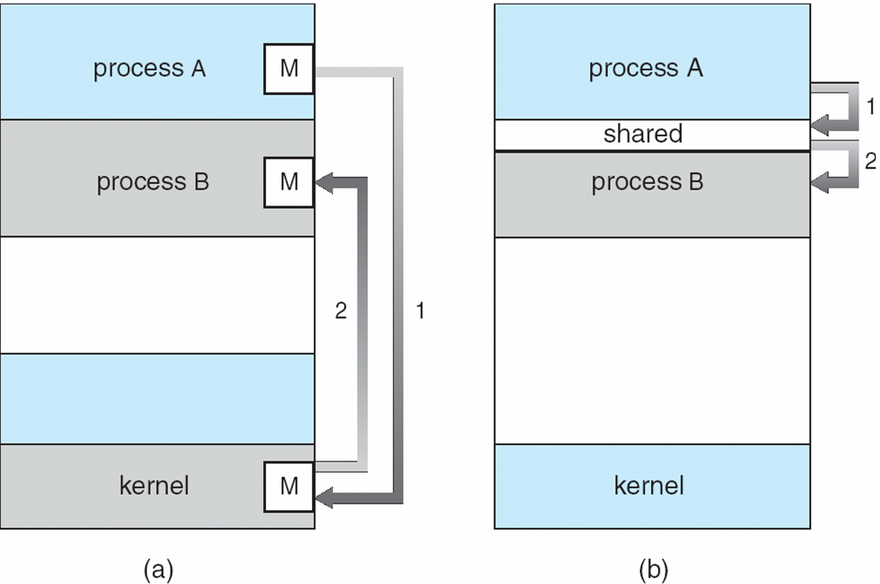
Communication Models
Communication may take place using either (a) message passing or (b) shared memory.

Slide 7
OS Services (system-oriented)
Resource allocation – When multiple users or multiple jobs running concurrently, resources must be allocated to each of them.
Accounting – To keep track of which users use how much and what kinds of computer resources

Slide 8
Common System Components
Process Management
Main Memory Management
Storage/File System Management
I/O System Management
Mass-Storage Management
Networking
Command Interpreter
Protection and Security

Slide 9
Process Management (1)
A process is a program in execution. It is a unit of work within the system.
Program is a passive entity, process is an active entity.
The operating system is responsible for the following activities in connection with process management:
Creating and deleting both user and system processes.
Suspending and resuming processes.
Providing mechanisms for process synchronization.
Providing mechanisms for process communication.
Providing mechanisms for deadlock handling.

Slide 10
Process Management (2)
A Process needs resources to accomplish its task:
CPU, memory, I/O devices, files
Initialization data
Process termination requires reclaim of any reusable resources.
Single-threaded process has one program counter specifying location of next instruction to execute
Process executes instructions sequentially, one at a time, until completion.
Multi-threaded process has one program counter per thread.
Typically a system has many processes, some user, some operating system running concurrently on one or more CPUs
Concurrency by multiplexing the CPUs among the processes/threads.

Slide 11
Main Memory Management
To execute a program all (or part) of the instructions must be in memory.
All (or part) of the data that is needed by the program must be in memory.
Memory management determines what is in memory and when
Optimizing CPU utilization and computer response to users.
Memory management activities:
Keeping track of which parts of memory are currently being used and by whom.
Deciding which processes (or parts thereof) and data to move into and out of memory.
Allocating and de-allocating memory space as needed.

Slide 12
Storage/File System Management
A file is a collection of related information.
Commonly, files represent programs (both source and object forms) and data.
Files are usually organized into directories.
Access control on most file systems to determine who can access what.
OS activities include:
Creating and deleting files and directories.
Primitives to manipulate files and directories.
Mapping files onto secondary storage.
Backup files onto stable (non-volatile) storage media.

Slide 13
I/O System Management
One purpose of OS is to hide peculiarities of hardware devices from the user.
I/O subsystem is responsible for:
Memory management of I/O including buffering (storing data temporarily while it is being transferred), caching (storing parts of data in faster storage for performance), spooling (the overlapping of output of one job with input of other jobs).
General device-driver interface.
Drivers for specific hardware devices.

Slide 14
Mass-Storage Management
Usually disks used to store data that does not fit in main memory or data that must be kept for a “long” period of time.
Proper management is of central importance.
Entire speed of computer operation hinges on disk subsystem and its algorithms.
OS activities:
Free-space management
Storage allocation
Disk scheduling
Some storage need not be fast:
Tertiary storage includes optical storage, magnetic tape
Varies between WORM (write-once, read-many-times) and RW (read-write)

Slide 15
Networking
The processors in the system are connected through a communication network.
Communication takes place using a protocol.
A networked/distributed system provides user access to various system resources.
Access to a shared resource allows:
Computation speed-up
Increased data availability
Enhanced reliability

Slide 16
Command Interpreter
Command-Interpreter:
The program that reads and executes commands given to the operating system.
Examples of command-line interpreters are command.com (DOS), shell (UNIX).
In windows systems the interface is mouse and menu based – WIMP (Windows, Icons, Menu, and Pointing device).

Slide 17
Graphical User Interface (GUI)
User-friendly desktop metaphor interface:
Usually mouse, keyboard, and monitor.
Icons represent files, programs, actions, etc.
Various mouse buttons over objects in the interface cause various actions (provide information, options, execute function, open folder).
Invented at Xerox PARC.
Systems now include both CLI and GUI interfaces:
Microsoft Windows is GUI with CLI “command” shell.
Apple Mac OS X as “Aqua” GUI with UNIX kernel underneath and shells available.
Solaris is CLI with optional GUIs (Java Desktop, KDE).

Slide 18
Protection and Security
Protection – any mechanism for controlling access of processes or users to both system and user resources.
Security – defense of the system against internal and external attacks, with huge range, including:
Denial-of-service
Worms
Viruses
Identity theft
Theft of service.

Slide 19
Protection Aspects
Systems generally first distinguish among users, to determine who can do what:
User identities (user IDs, security IDs) include name and associated number, one per user.
User ID then associated with all files, processes of that user to determine access control.
Group identifier (group ID) allows set of users to be defined and controls managed, then also associated with each process, file.
Privilege escalation allows user to change to effective ID with more rights.

Slide 20
Error Detection/Response
Error Response
simply report error to the application
Retry the operation
Abort the application
Error Detection
internal and external hardware errors
memory error
device failure
software errors
arithmetic overflow
access forbidden memory locations

Slide 21
Accounting
Accounting keeps track of and records which users use how much and what kinds of computer resources.
Accounting:
collect statistics on resource usage
monitor performance (e.g., response time)
used for system parameter tuning to improve performance
useful for anticipating future enhancements
used for billing users (on multi-user systems)

Slide 22
System Calls and APIs
A system call is a request made by a program to the operating system. It allows an application to access functions and commands from the operating system's API. System calls perform system-level operations, such as communicating with hardware devices and reading and writing files.

